Slide 1
Image Super Resolution with Plug-and-play
Diyu Yang

Slide 2
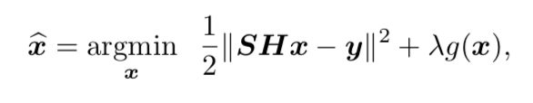
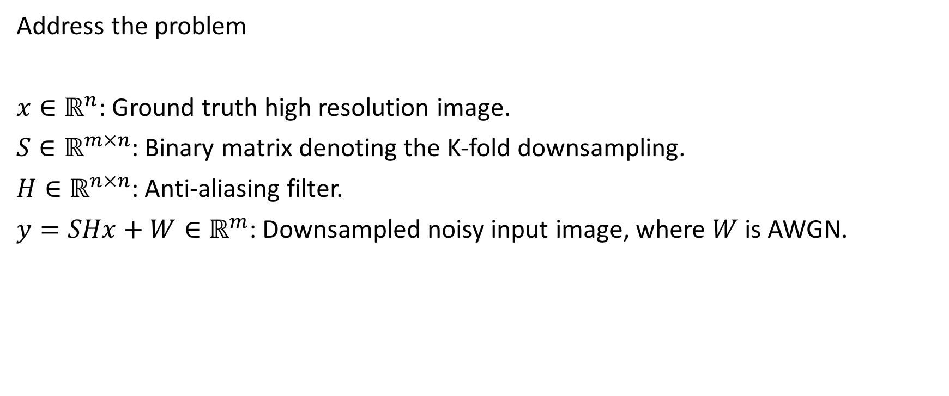
Problem overview
Address the problem
$x∈ℝ^{n}$: Ground truth high resolution image.
$S∈ℝ^{m×n}$: Binary matrix denoting the K-fold downsampling.
$H∈ℝ^{n×n}$: Anti-aliasing filter.
$y=SHx+W∈ℝ^{m}$: Downsampled noisy input image, where $W$ is AWGN.

Slide 3
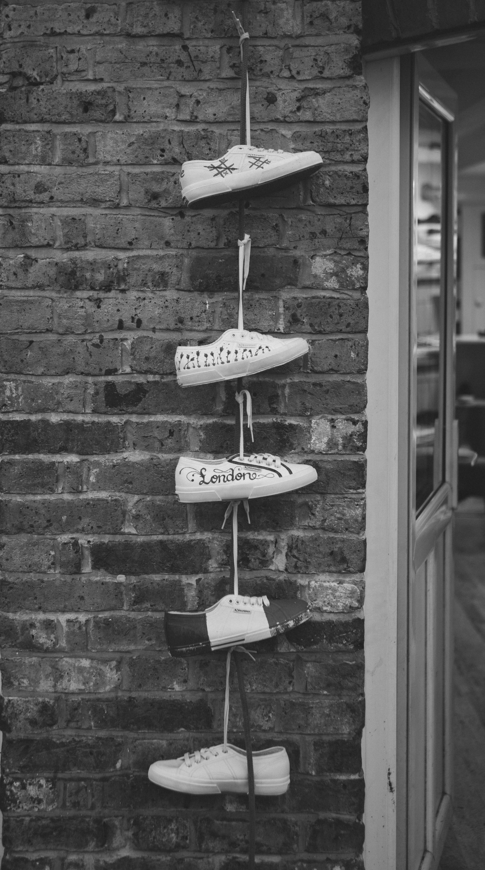
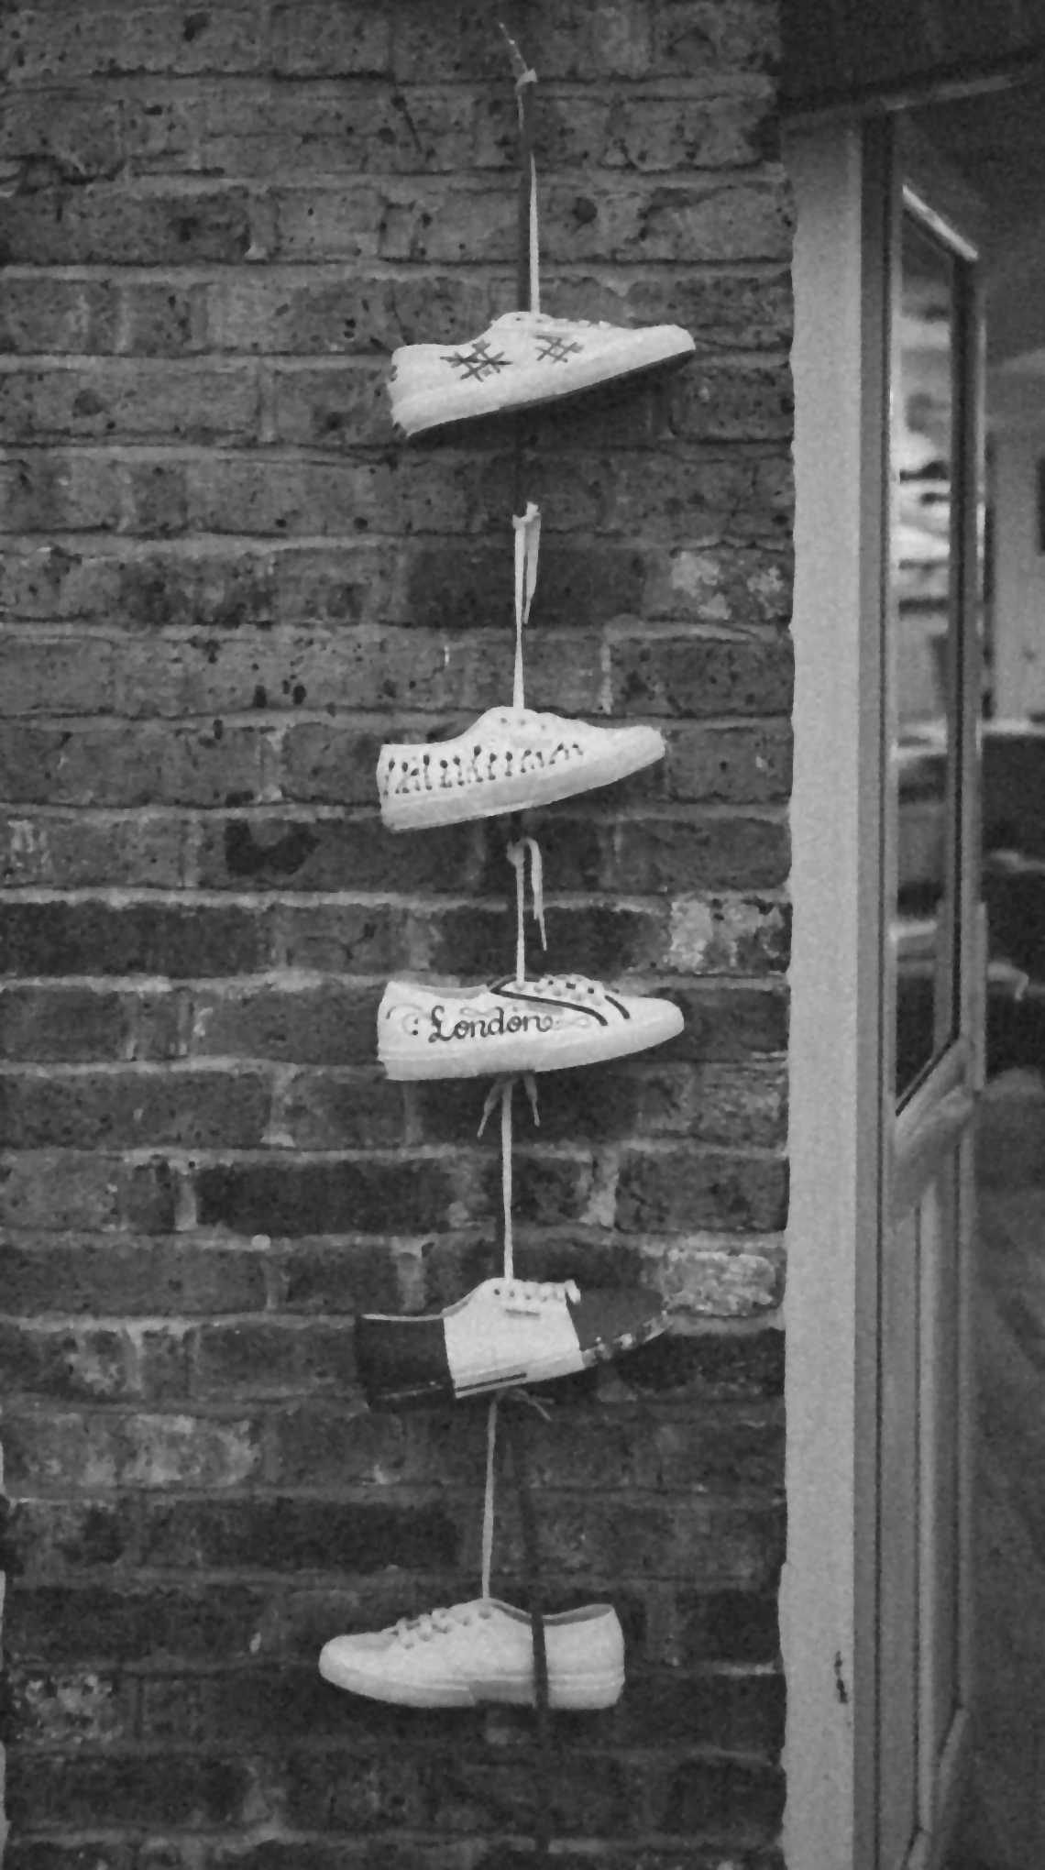
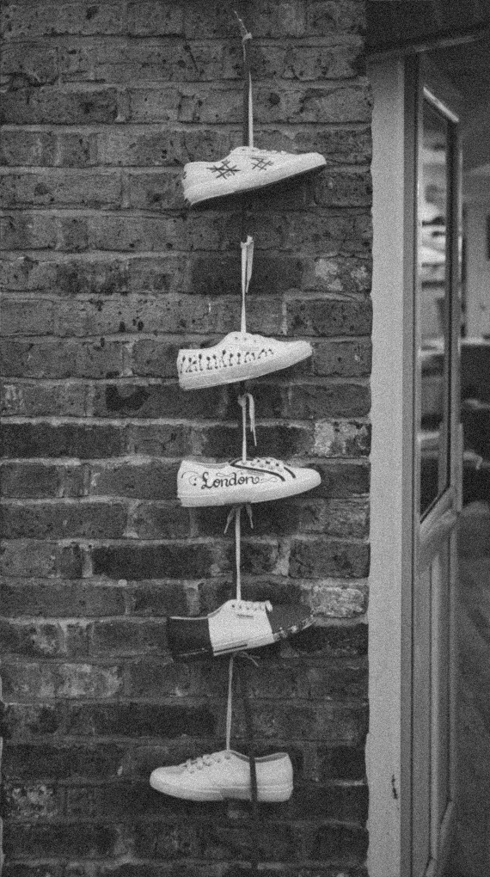
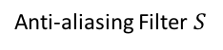
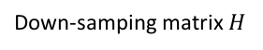
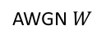
Problem overview
Address the problem
Anti-aliasing Filter $S$
Down-samping matrix $H$
Plug-and-play
AWGN $W$
$x$: Ground truth $y$: Down-sampled input image $\hat{x}$: Restored output image

Slide 4
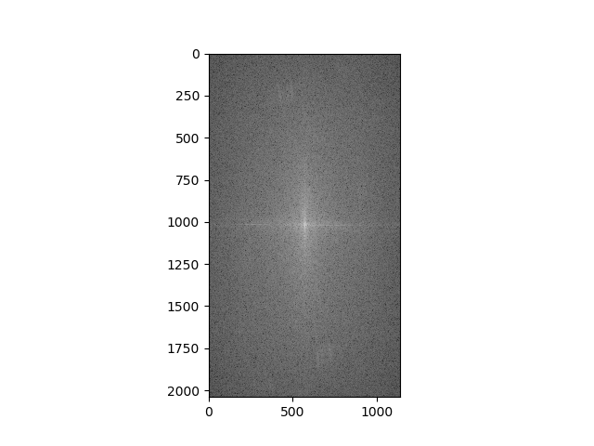
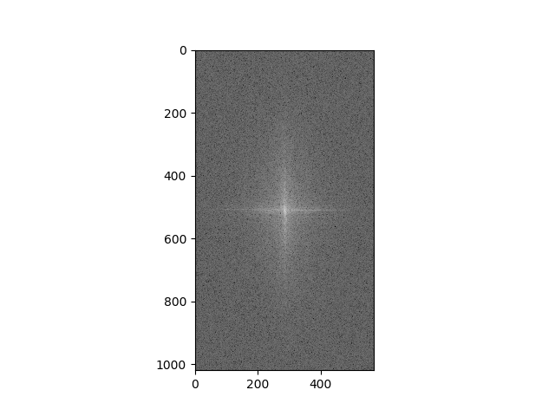
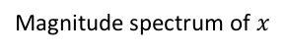
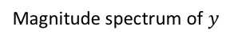
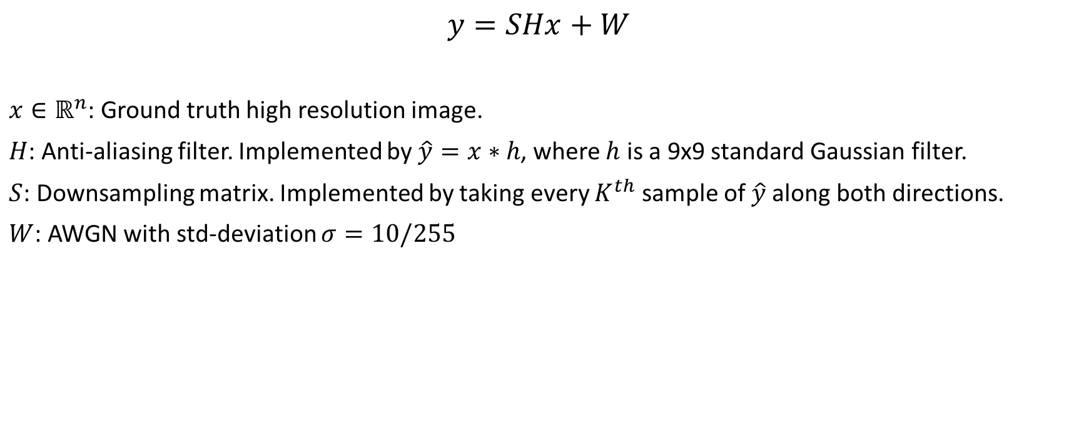
Data pre-processing
$$y=SHx+W$$
$x∈ℝ^{n}$: Ground truth high resolution image.
$H$: Anti-aliasing filter. Implemented by $\hat{y}=x∗h$, where $h$ is a 9x9 standard Gaussian filter.
$S$: Downsampling matrix. Implemented by taking every $K^{th}$ sample of$\hat{y}$ along both directions.
$W$: AWGN with std-deviation $σ=10/255$
Point spread function of h
Magnitude spectrum of $x$
Magnitude spectrum of $y$

Slide 5
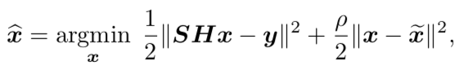
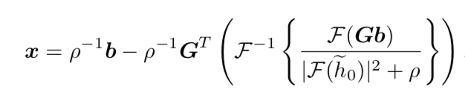
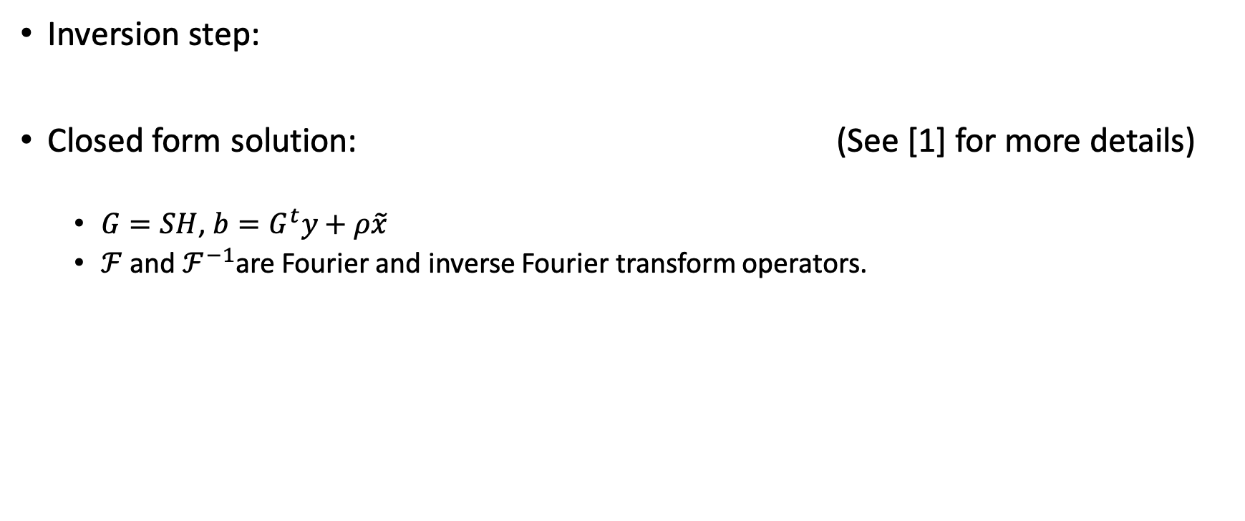
Plug-and-play: forward model optimization
Inversion step:
Closed form solution: (See [1] for more details)
$G=SH$, $b=G^{t}y+ρ\tilde{x}$
$ℱ$ and $ℱ^{−1}$are Fourier and inverse Fourier transform operators.

Slide 6
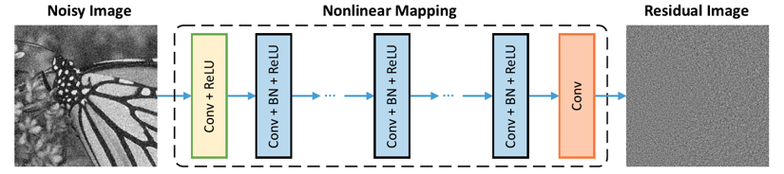
Plug-and-play: CNN denoiser as Prior
Paper: Zhang et al. 2017 ([2])
Network Architecture
Architecture is designed to handle Gaussian denoising with unknown noise level.

Slide 7
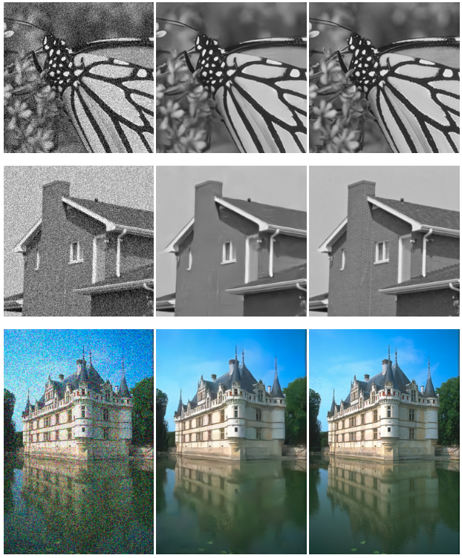
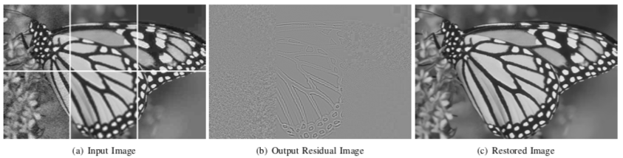
Plug-and-play: CNN denoiser as Prior
Denoising results
Noisy image Denoised image Ground truth

Slide 8
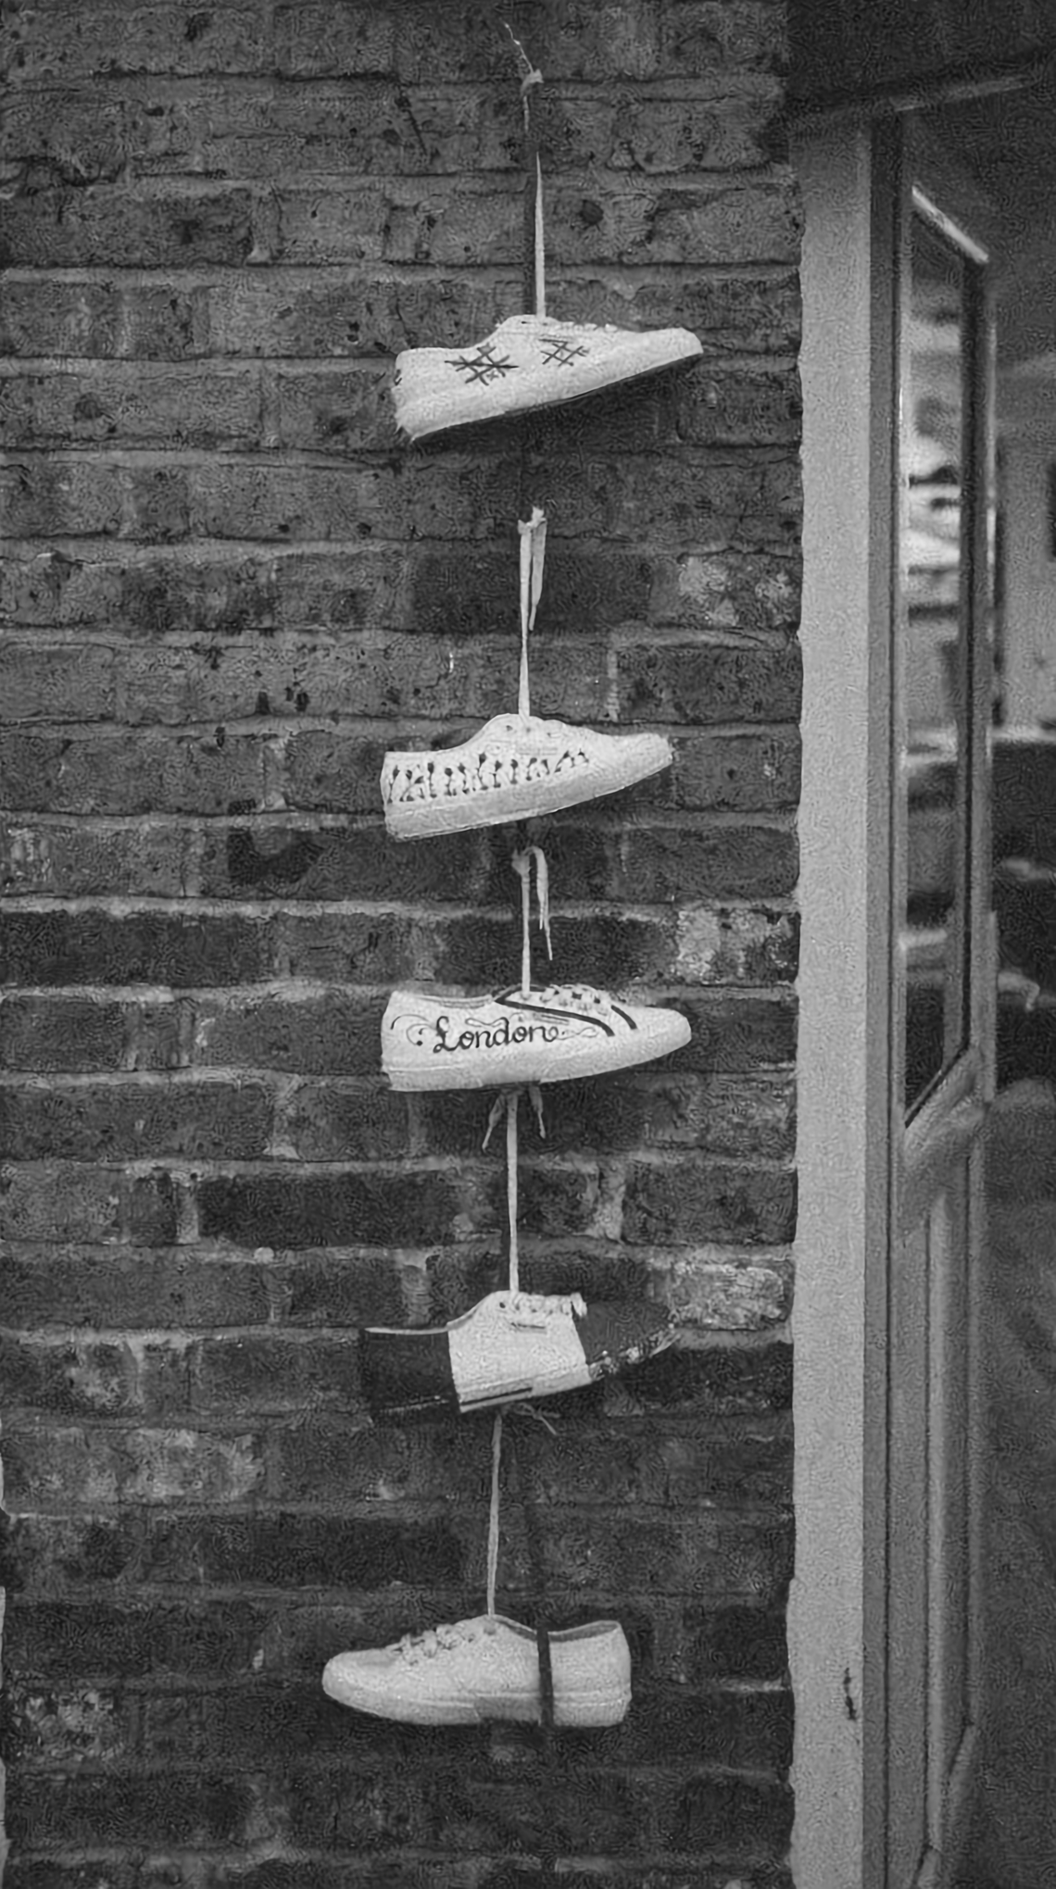
Plug-and-play: Results 2x upsampling
Input: 2x downsampled
Ground truth
Output: 2x upsampled

Slide 9
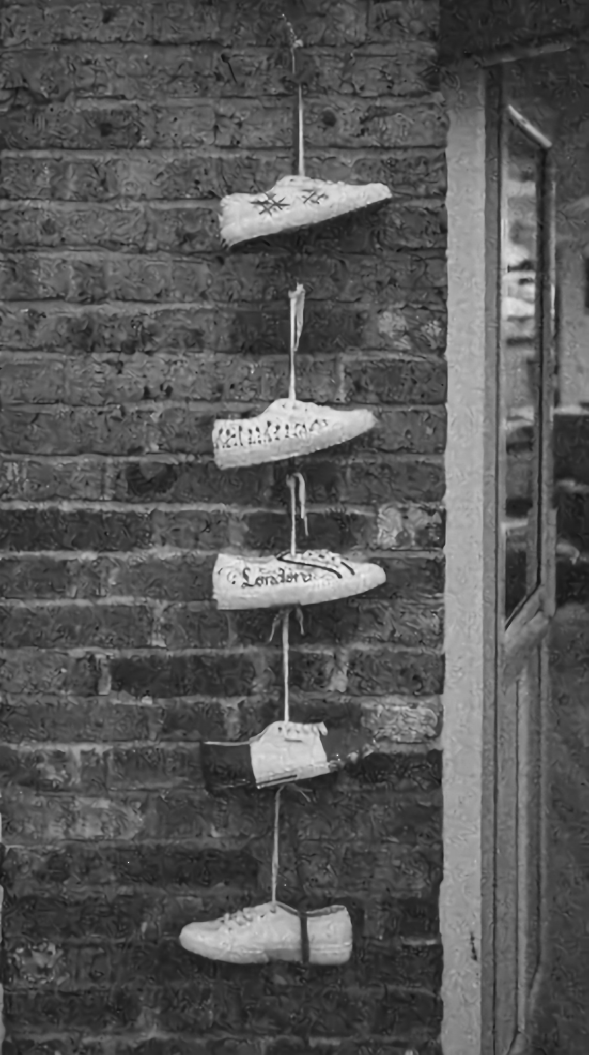
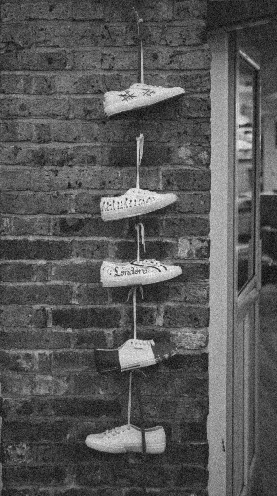
Plug-and-play: Results 4x upsampling
Input: 4x downsampled
Ground truth
Output: 4x upsampled

Slide 10
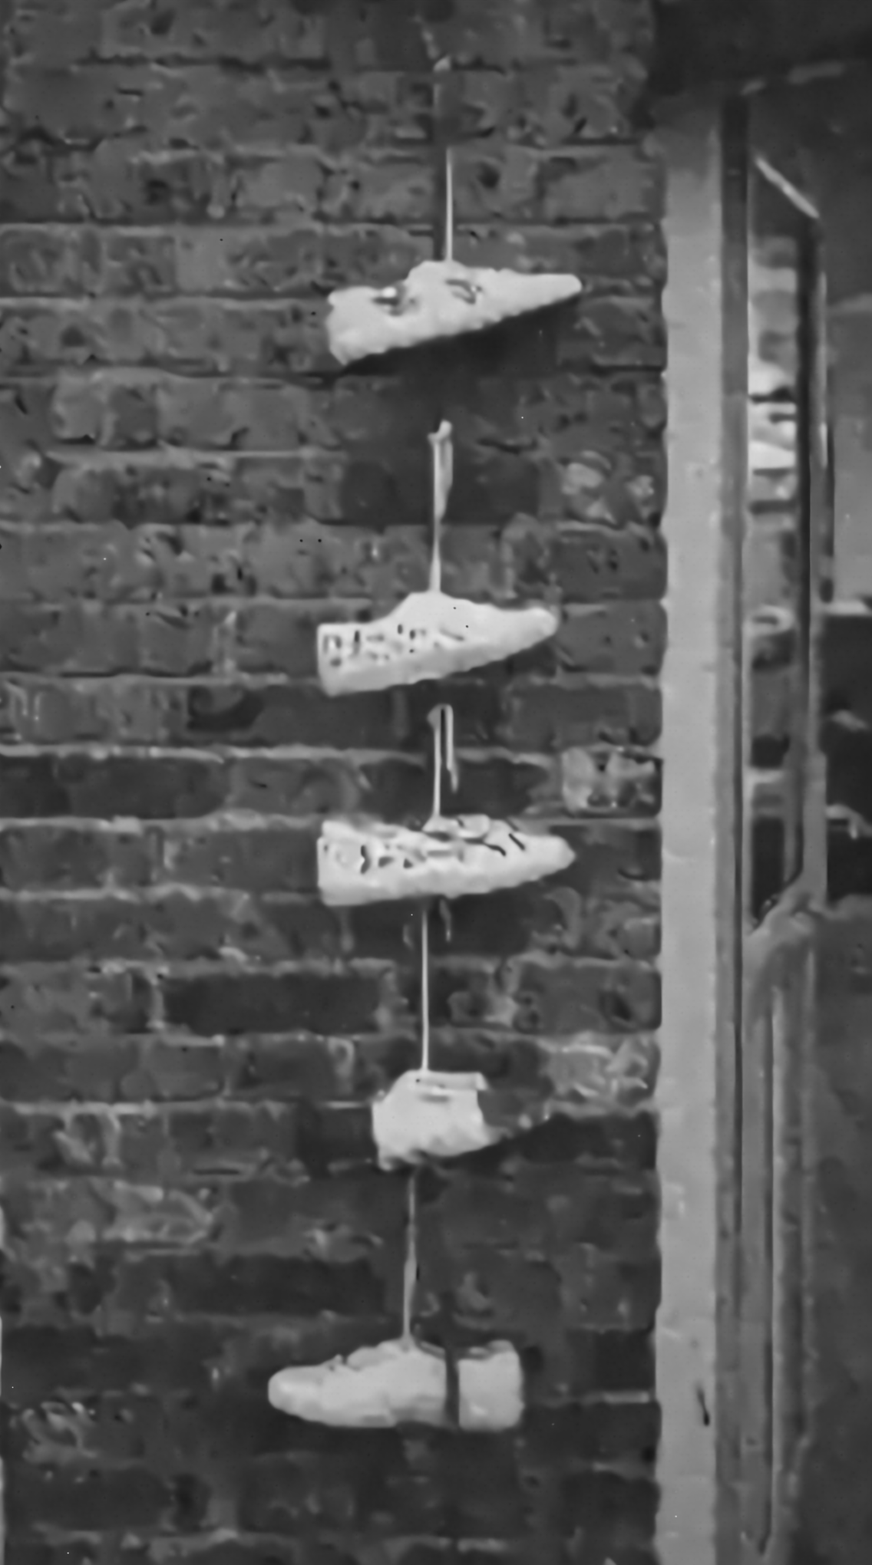
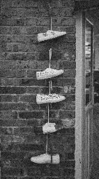
Plug-and-play: Results 8x upsampling
Input: 8x downsampled
Ground truth
Output: 8x upsampled

Slide 11
Plug-and-play: Results Comparison
Ground truth 2X down&up-samping restoration 4x down&up-samping restoration 8x down&up-samping restoration

Slide 12

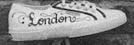
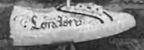
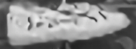
Plug-and-play: Results Comparison in detail
Ground truth 2X down&up-samping restoration 4x down&up-samping restoration 8x down&up-samping restoration

Slide 13
References
[1]. S. H. Chan, X. Wang, and O. A. Elgendy, “Plug-and-Play ADMM for image restoration: Fixed point convergence and applications,” IEEE Trans. Computational Imaging, 2016, In Press.
[2]. K. Zhang, W. Zuo, Y. Chen, D. Meng and L. Zhang, "Beyond a Gaussian Denoiser: Residual Learning of Deep CNN for Image Denoising," in IEEE Transactions on Image Processing, vol. 26, no. 7, pp. 3142-3155, July 2017.

